Slide 1


Hackmobility 2019
07-21-2019
Mobility for everyone
Pierre-Louis Missler
Antoine Roux
Andy Spezzatti
Anne Spitz

Slide 2
Context
65%
of older adults
40%
of older adults
40 Millions
People with disability in the US
Could not do all their activities because of mobility barriers (2018)
Live in rural areas in the US
Notes:
We start we the constat that today lot of elderly feel isolated because they lack the tech knowledge to use modern transportation options

Slide 3







Solution
Vocal assistant
Speech recognition
NLP
Automated selection & reservation
Notes:
Our solution is an end to end vocal assistant that leveral state of the art speech recognition and nlp technology to provide a fully automated selection and reservation service

Slide 4
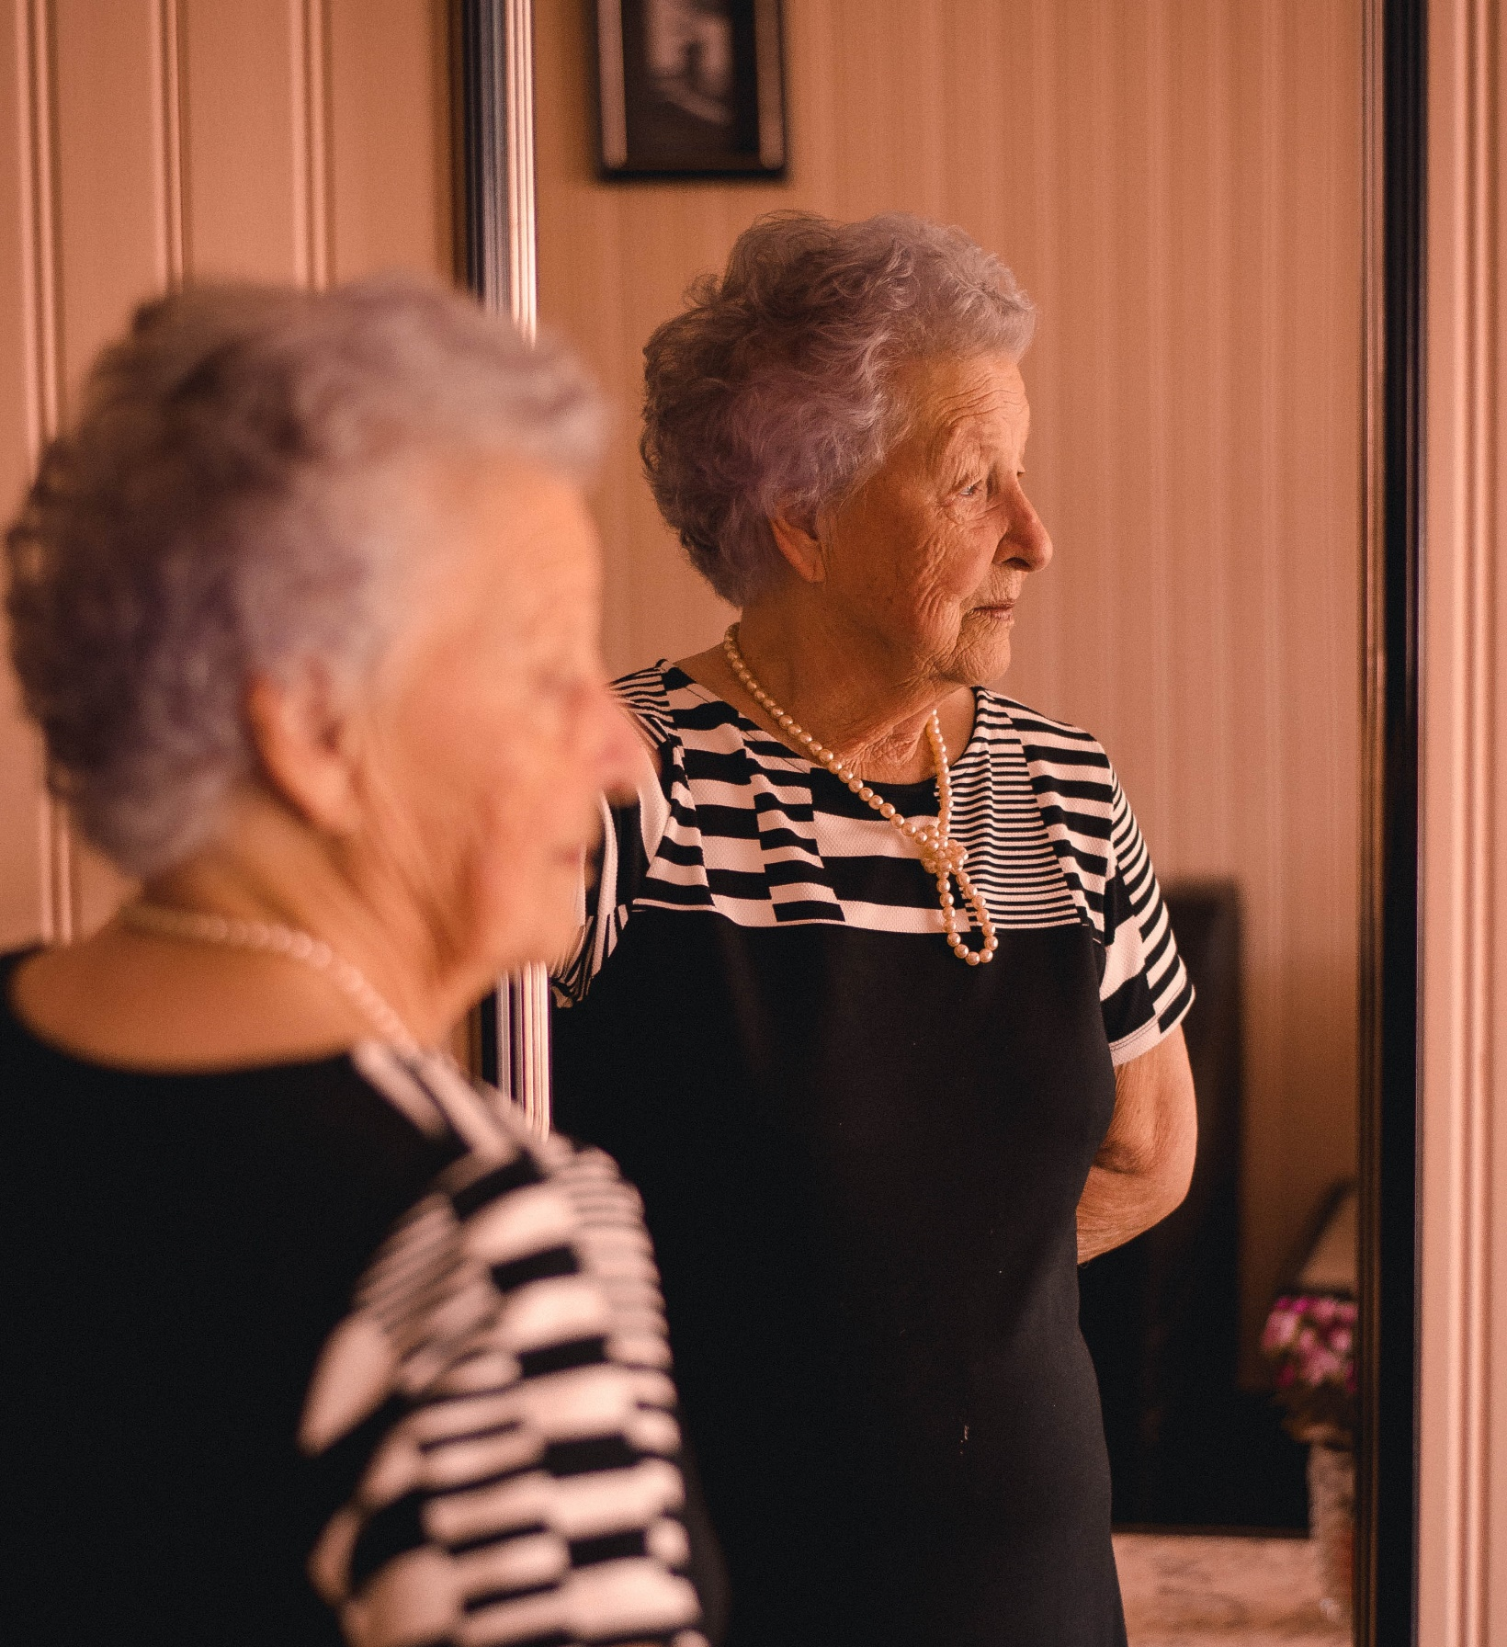
Notes:
Let’s meet Daisy. Daisy usually feels frustrated because she regularly miss her lunck with Pablo and Tina and struggle to go to the supermarket, because she does not have any transportation option. She does not use internet or a mobile phone on regular basis and therefore does not know how to find a solution. Yet, a week ago Pablo told her about SpeaknGo.

Slide 5
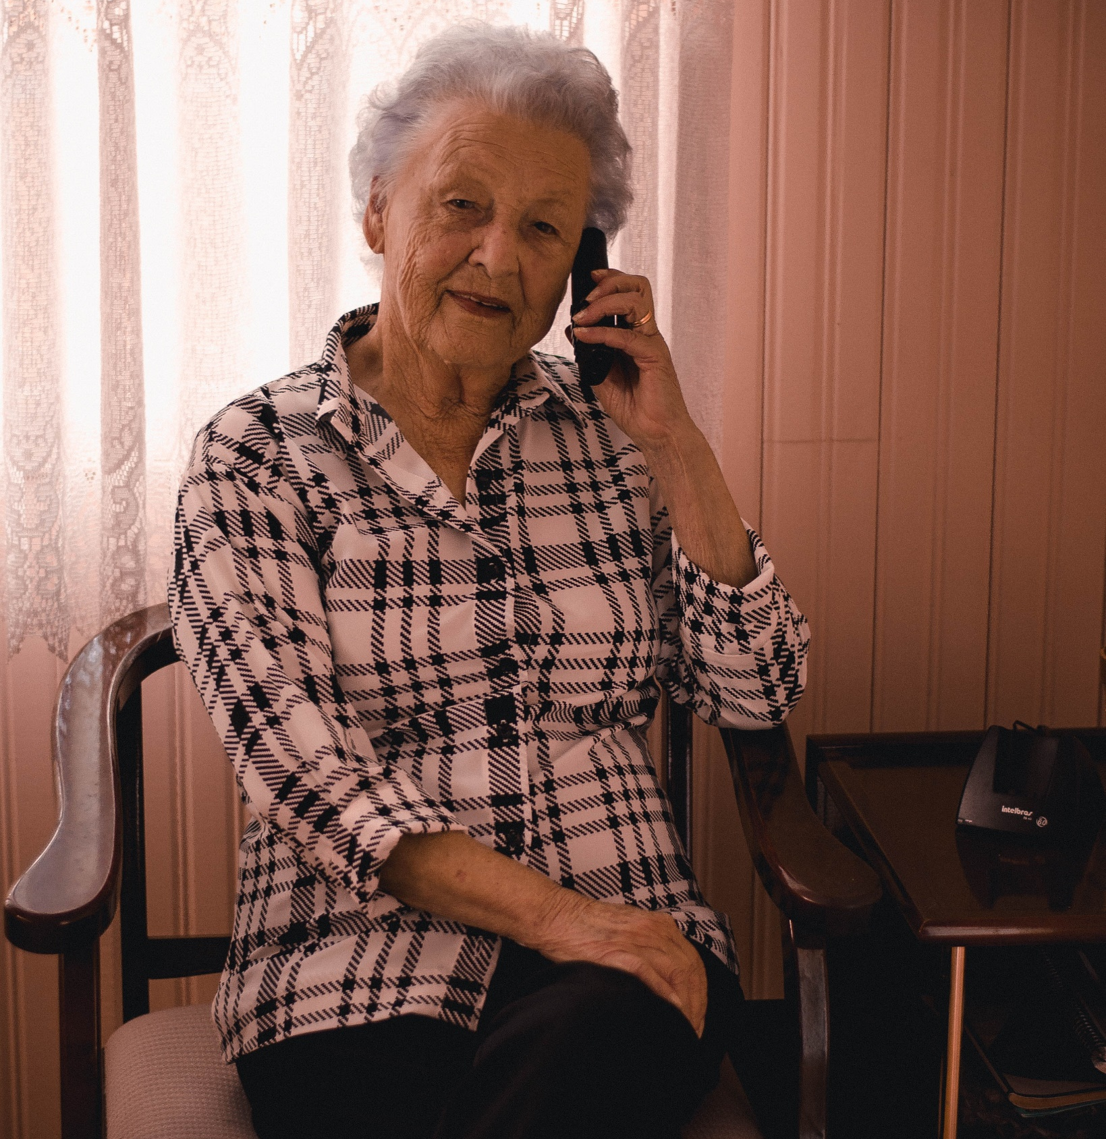
Notes:
But last week, Pablo introduces her to Speakngo. Now she just have to call the speakngo number, tell him where she want to go, and everything his handled for her

Slide 6
« Hi Speak&Go, I want to go to the Walmart this afternoon »

Slide 7
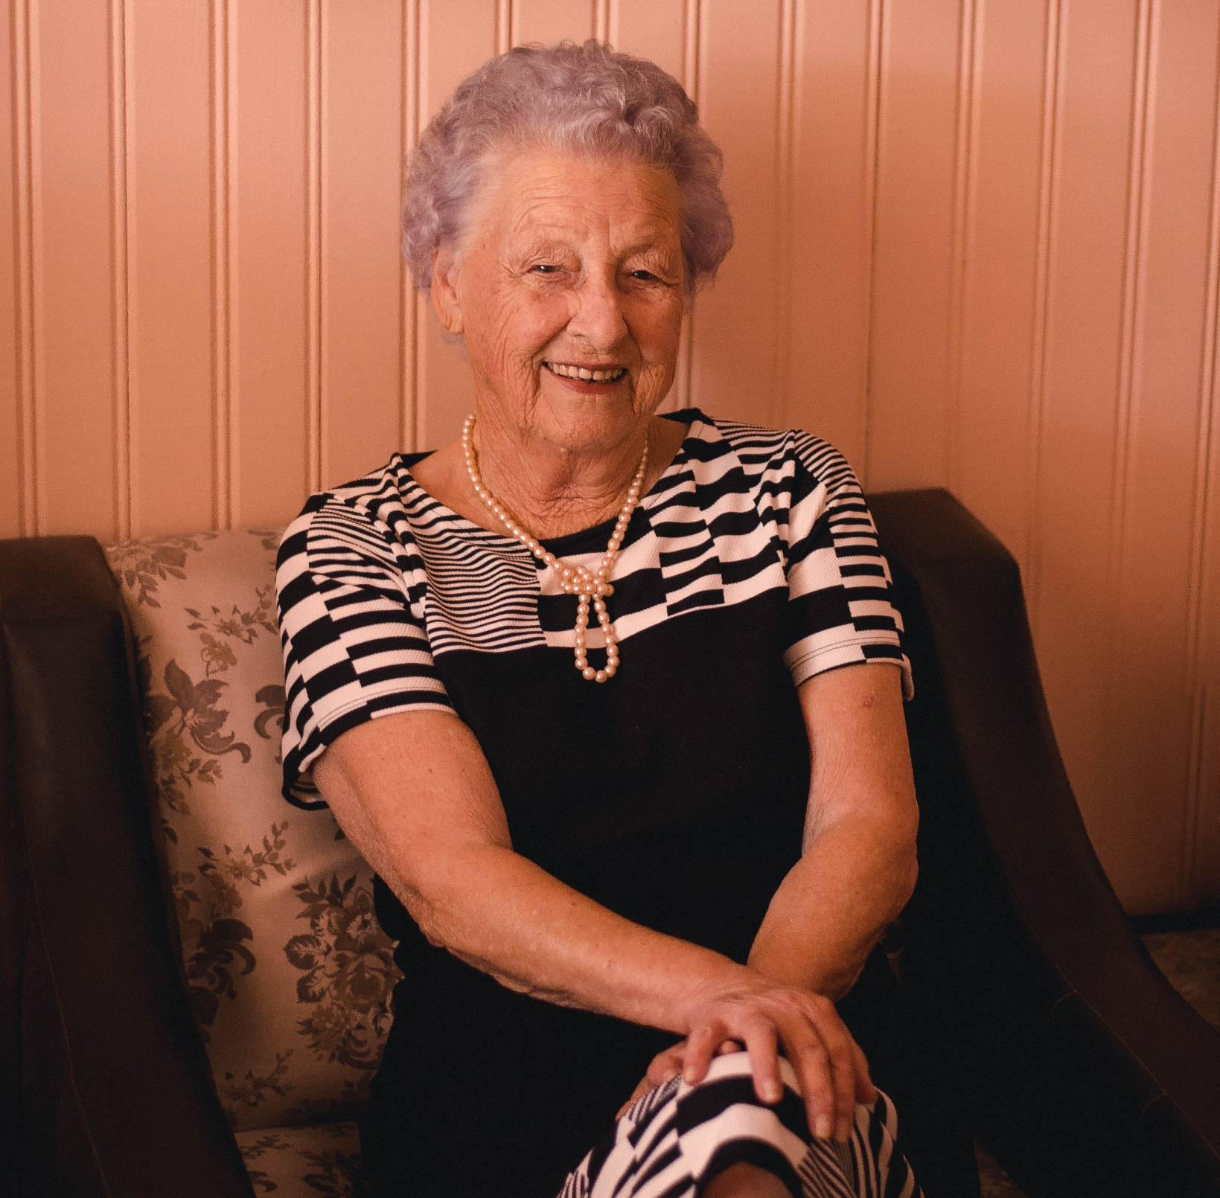
Notes:
She can return to her daily activities and at a given time a remider is given to her when she will need to go

Slide 8

Give a reminder before the trip

Slide 9
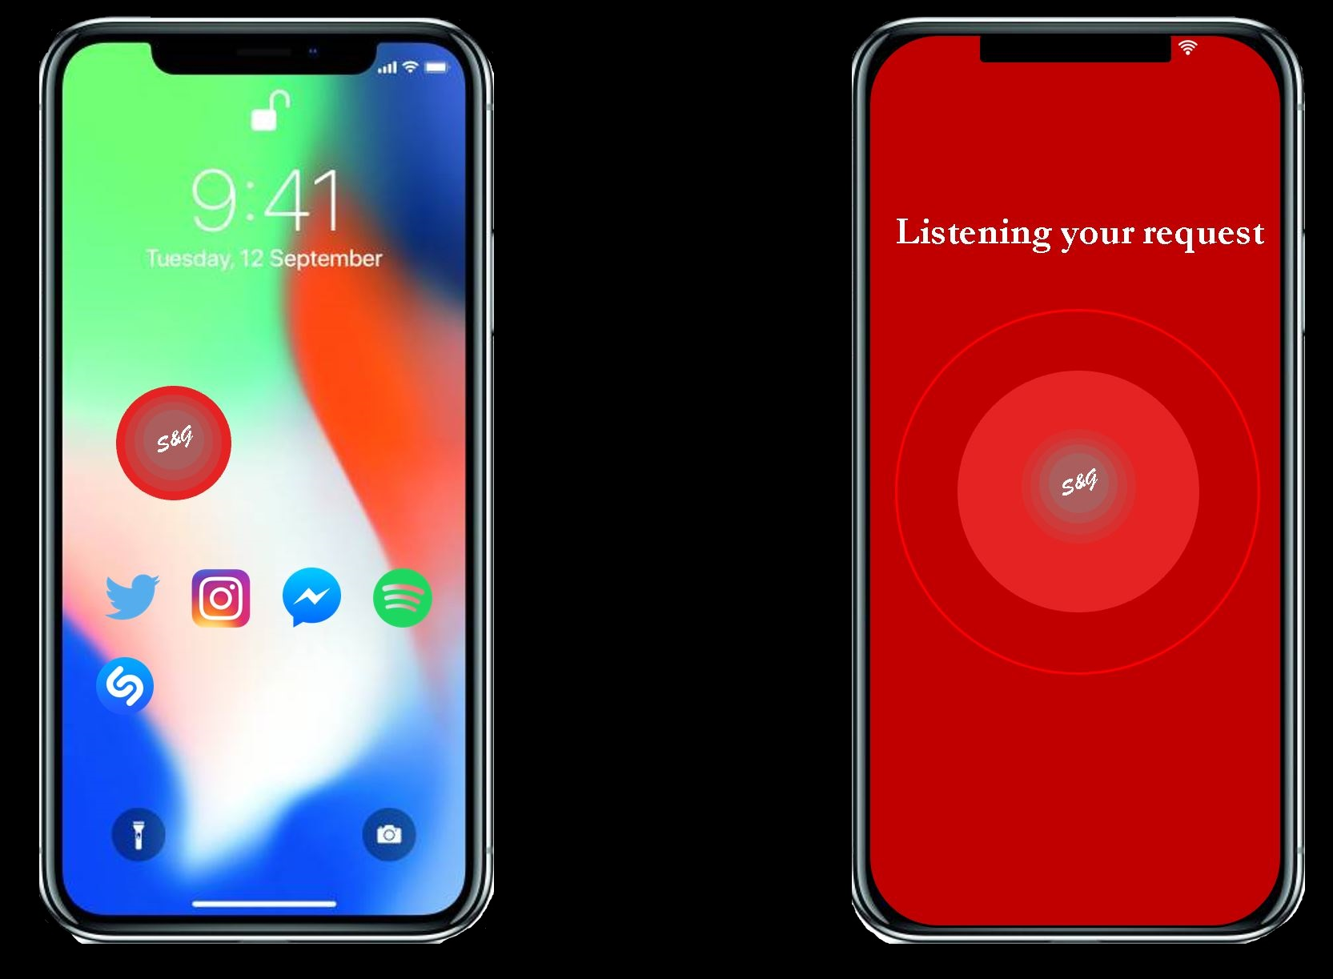
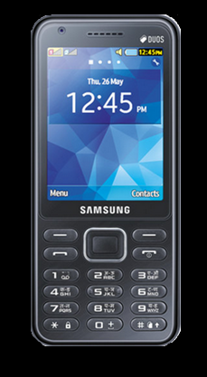
Two User Interfaces
Call
(510) 712 3217

Slide 10
DEMO

Slide 11
Growth Strategy
3
2
Before June 2020
- Country wide deployment
1
Before Decembre 2019
App development
Growth of customer base
August -September 2019
Development transportation options
Uber API
Mobility for Everyone

Slide 12
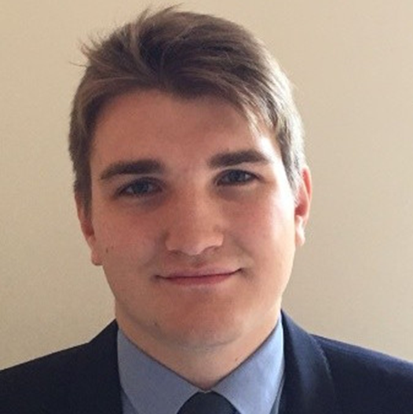
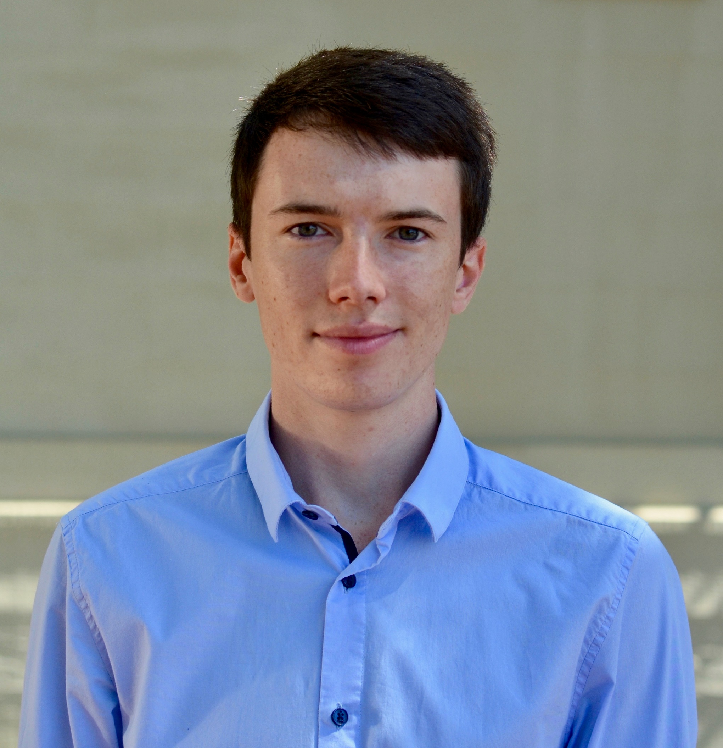
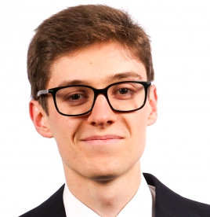
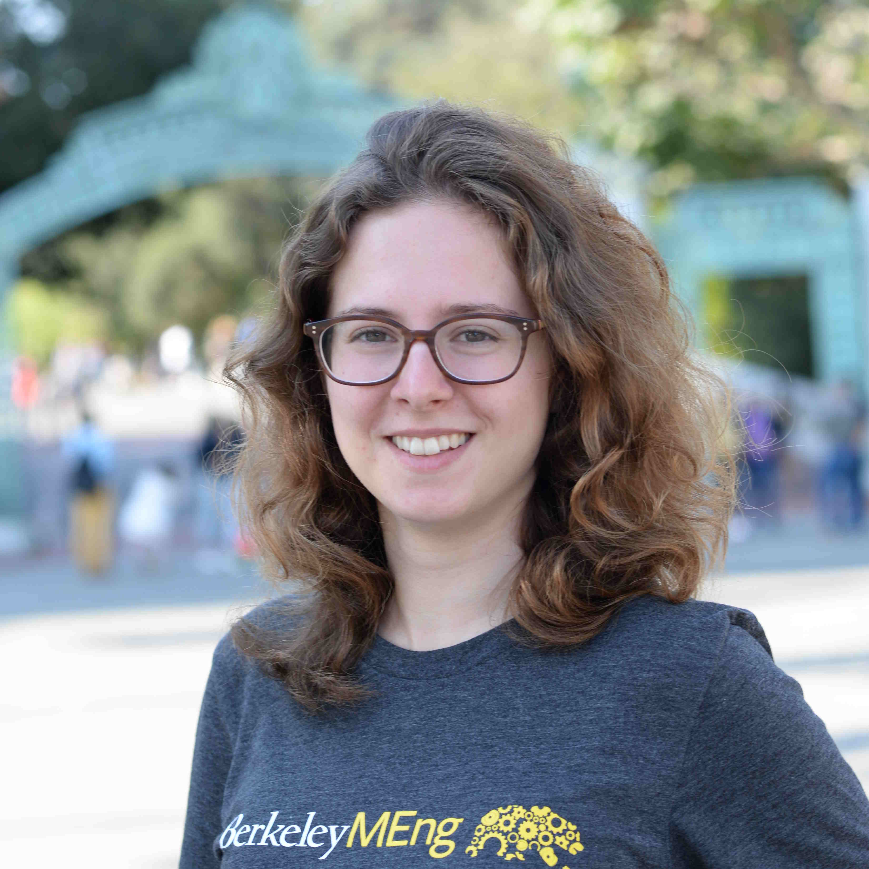
Team
Pierre-Louis Missler
Antoine Roux
Andy Spezzatti
Anne Spitz
Consultant – Data Analyst
System Integration Engineer
NLP Engineer
Data Scientist
Mobility for everyone

